Slide 1
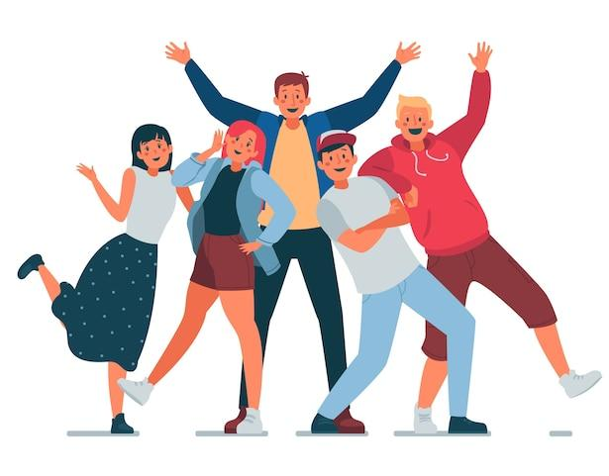
CLASSROOM RULES
Be on time
Be interactive
100% or Nothing
Do all Daily Challenges

Slide 2
Review
Notes:
https://create.kahoot.it/details/48a5f48b-8f56-42d0-afe7-77cff925d97a?drawer=

Slide 3
GRAMMAR + VOCABULARY + SHADOWING
1. It's really interesting. And I meet lots of interesting people.
2. It’s an interesting job, and it’s good for me because I love travel and flying.
3. It’s hard work, but the pay’s good and it keeps me in shape.
4. I’m trying to find a new job.
5. How do you like your job?
6. I do the same thing every day. I’m really sick of it.
7. I love working with kids. They’re so much fun.
8. What do you like best about your job?
9. The only trouble is, I have to travel a lot.
10. I don’t like the long hours. I’m always really tired when I get home at night.

Slide 4
SPEAKING
What do you do?/ What is your dream job?
What do you like about this job?
Is there anything you don’t like about this job?
What does your father/ mother/ brother/ sister do?

Slide 5
Lesson 7
Countable and uncountable nouns
Quantifiers

Slide 6
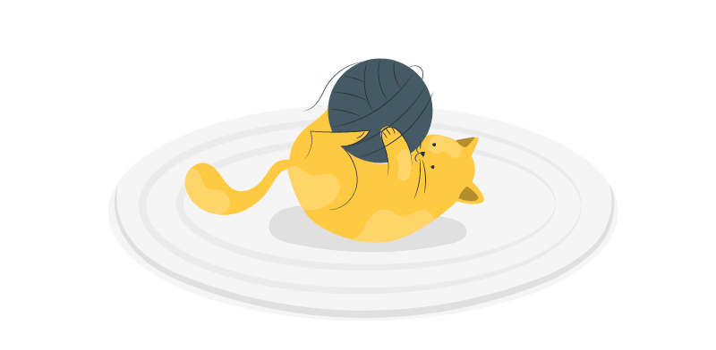


Can we count?
Countable nouns
Uncountable nouns

Slide 7
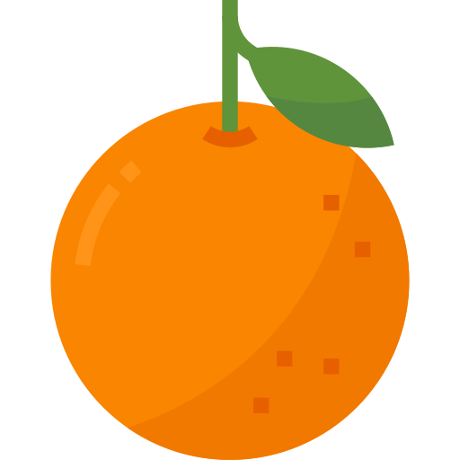
Can we count oranges?
Yes!
an orange
two oranges

Slide 8
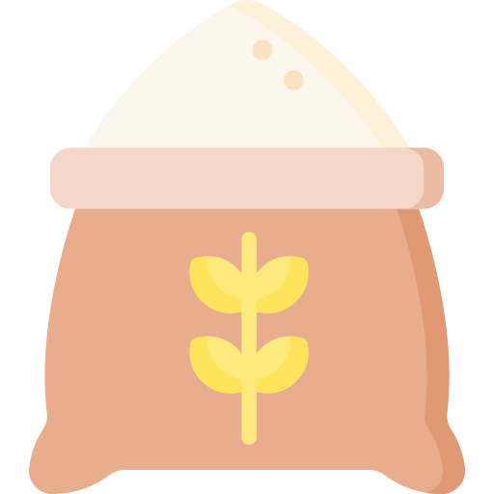
Can we count rice?
No!
some rice

Slide 9
Countable nouns
Uncountable nouns
Dùng được với số đếm
Không dùng được với số đếm
Có dạng số ít và số nhiều
Luôn đi với động từ chia số ít
Danh từ số ít cần đi kèm với mạo từ a/an hoặc the.
One/A book – Two books
One/A chair – Three chairs
One/A doctor – Five doctors
One/An engineer - Ten engineers
Không có hình dạng nhất định: Smoke, air, water, wind, butter, cheese, meat, bread
Quá nhỏ và không thể đếm: Rice, sugar, salt
Khái niệm trừu tượng: Beauty, fear, information, knowledge, hope
a piece of furniture, news, info…
2 pieces of

Slide 10
QUANTIFIERS
(Lượng từ)
Mercury

Slide 11


SOME
Câu khẳng định
(N không đếm được)
There is some water.
Câu khẳng định
(N đếm được, số nhiều)
There are some students.

Slide 12

SOME
Would you like some coffee?
Yes, please.
Câu mời/ đề nghị

Slide 13
ANY
Câu hỏi
(N đếm được - số nhiều)
Are there any oranges?
There aren’t any oranges.
Câu phủ định
(N đếm được - số nhiều)
Câu hỏi
(N không đếm được)
Is there any coffee?
There isn’t any coffee.
Câu phủ định
(N không đếm được)

Slide 14
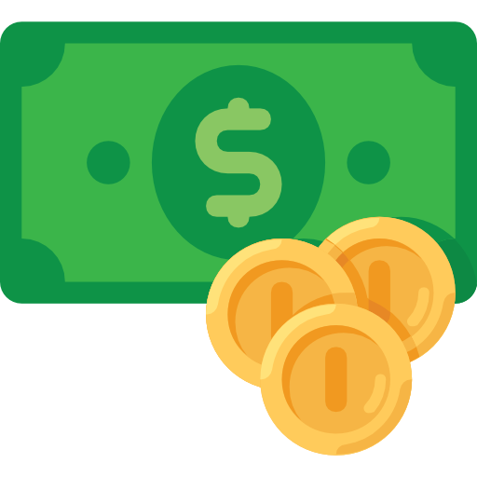
A few vs A little
There are a few students.
There is a little money.
Câu khẳng định
(N đếm được, số nhiều)
Câu khẳng định
(N không đếm được)

Slide 15
Many vs Much
There aren’t many students.
There isn’t much money.
Câu phủ định
(N đếm được, số nhiều)
Câu phủ định
(N không đếm được)

Slide 16
Many vs Much
How many students are there?
How much money do you have?
Câu hỏi
(N đếm được, số nhiều)
Câu hỏi
(N không đếm được)

Slide 17
Many vs A lot of
There are many students.
That’s a lot of money .
Câu khẳng định
(N đếm được, số nhiều)
Không dùng much trong câu khẳng định => “a lot of"
Notes:
Much dùng trong câu kd trường hợp tiêu cực, khi ng nói ko mong muốn nó xảy ra

Slide 18


A LOT OF
Câu khẳng định
(N không đếm được)
There is a lot of sugar.
Câu khẳng định
(N đếm được, số nhiều)
There are a lot of books.

Slide 19
“Một/ một ít/ một vài"
N đếm được
(số ít)
N đếm được
(số nhiều)
N không đếm được
Câu khẳng định
a - an
some / a few
some / a little
Câu phủ định
a - an
any
any
Câu hỏi
a - an
any
any

Slide 20
“Nhiều/ rất nhiều"
N không đếm được
N đếm được (số nhiều)
Câu khẳng định
many/ a lot of
a lot of
Câu phủ định
many
much
Câu hỏi
How many
How much

Slide 21
Complete the sentence with the correct quantifier. There can be more than 1 correct answer:
1. Do you have any close friends?
I have _____good friend.She is very sociable, and she has _______________ friends. She gives me ______________ help when I need it, and she never has ______problem listening to me. I’m so lucky to have a friend like her.
a
a lot of / many
some / a lot of
any
2. What’s your mother like?
a
a lot of
My mom is ____wonderful woman. She’s very hard working. She has _________work, but she always finishes all of her tasks wonderfully. She’s taught me _____________valuable lessons.
many / a lot of

Slide 22
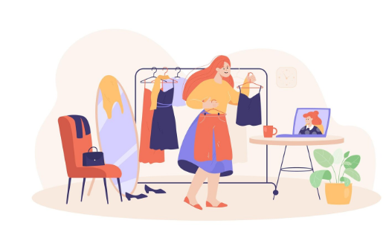
Complete the sentence with the correct quantifier. There can be more than 1 correct answer:
3. What kind of clothes does your mother wear?
My mother usually wears _____ dress when she goes out, because she has_______________ dresses in her closet. She doesn’t have _____________ accessories, but she always wears __________jewelry like a necklace. She rarely wears pants, because she doesn’t own ______ cotton pants, but sometimes she borrows mine.
a
A lot of
any
a piece of
many

Slide 23

GOODBYE!
See you later!

